Slide 1

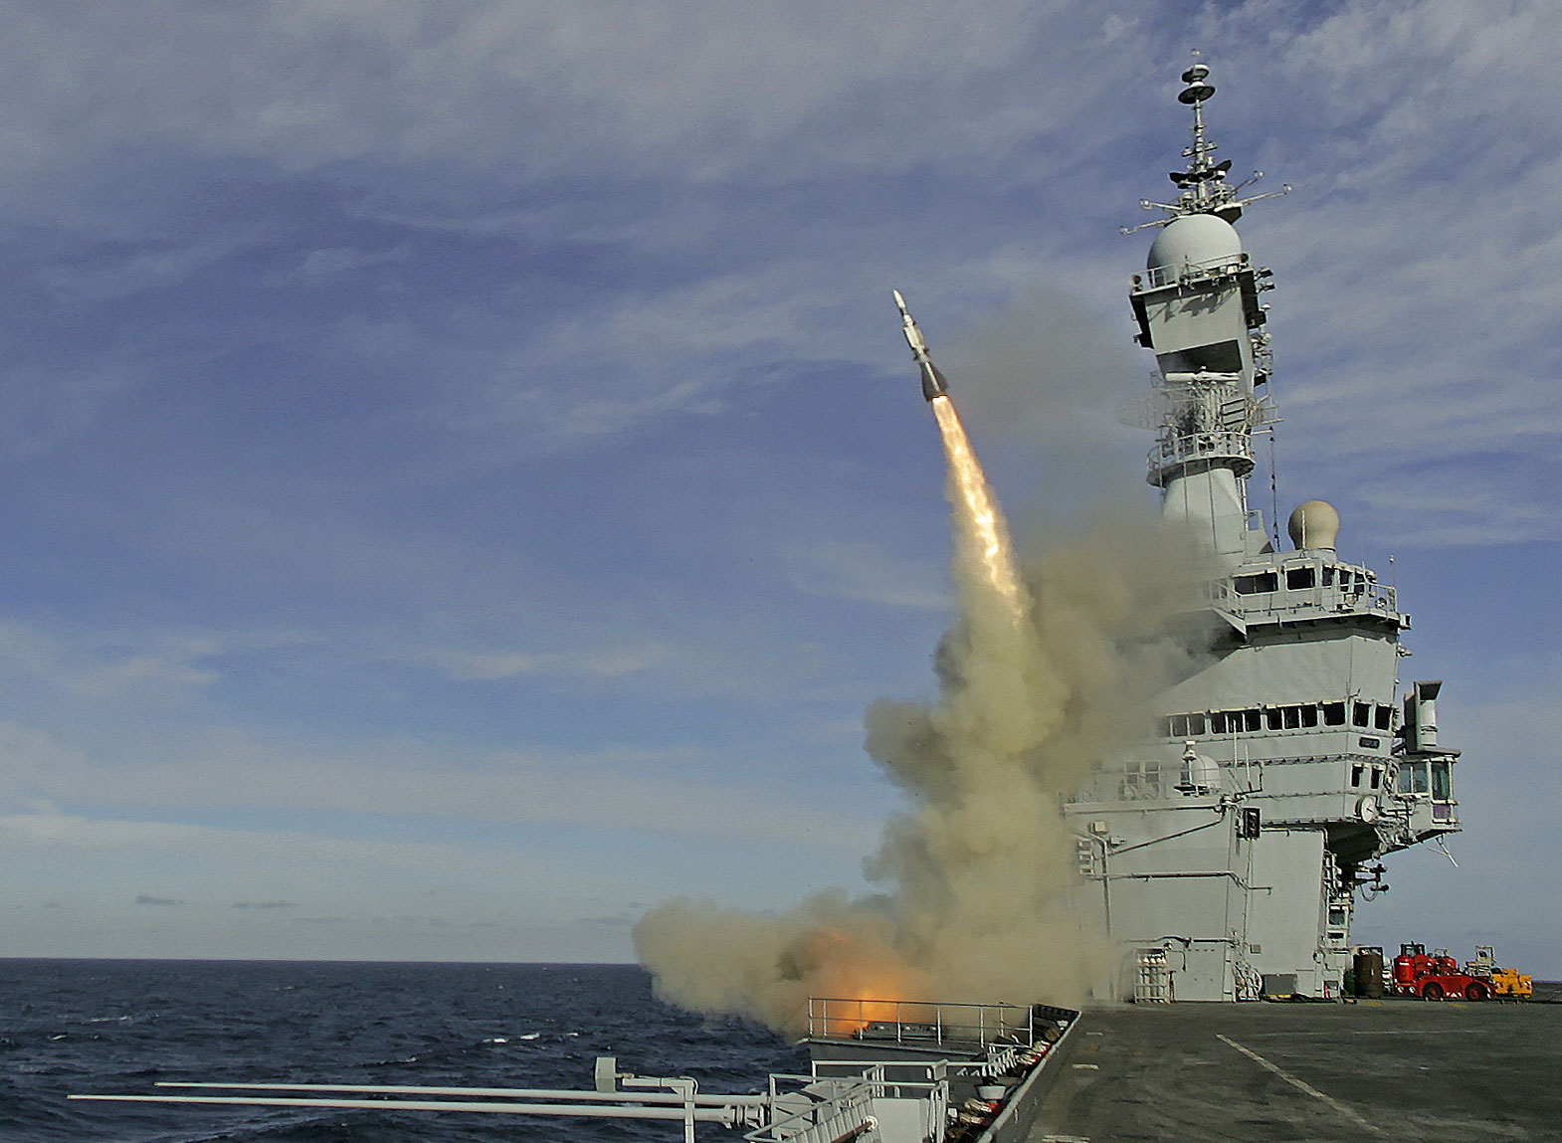
Sensor-rich control ASTER
Anatole Verhaegen
24/04/2015

Slide 2
Plan
ASTER 30 presentation
Basic Modelling
Controller Design
Weight Reduction

Slide 3
ASTER Presentation

Slide 4
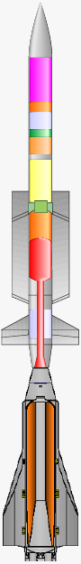
ASTER 30 features Acceleration phase
Thrust vector control
Link subject to bending
Sensor pack
Thrust
Booster
Dart

Slide 5
ASTER Modelling

Slide 6
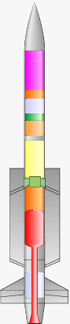
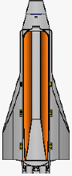
Rigid-body model (M1)
Turbulence
Speed
α₁
Structural model :
1 rigid rod
Constant mass
Aerodynamic model :
Lift applied at CG
Mach 4.5
Von Karman turbulence model
L
Thrust vector control

Slide 7
2 rigid-body model (M2)
Turbulence
α₁
Structural model :
2 rigid rods
1 torsion spring (1% damping)
Constant mass
Aerodynamic model :
Lift applied at CG of each rod
Mach 4.5
Von Karman turbulence model
L₁
L₂
Thrust vector control
α₂

Slide 8
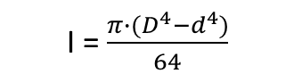
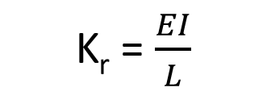
2 rigid-body model (M2)
α₂
d = 0.14 m
D = 0.18 m
E = 210 GPa (steel)
I = $\frac{π∙(D^{4}−d^{4})}{64}$
K_{r}
L = 0.2 m
K_{r} = $\frac{EI}{L}$
α₁

Slide 9
Controller Design

Slide 10
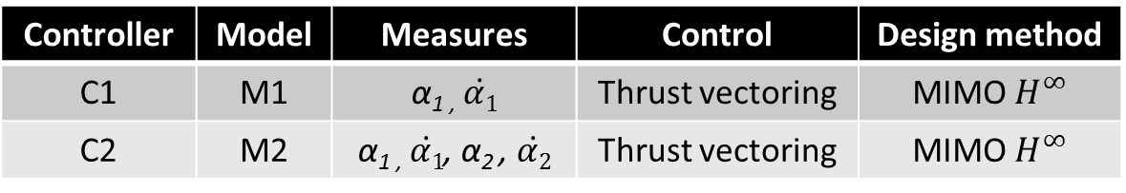
Controller Design
Controller | Model | Measures | Control | Design method
C1 | M1 | α_{1 ,} $\dot{α1}$ | Thrust vectoring | MIMO $H^{∞}$
C2 | M2 | α_{1 ,} $\dot{α1}$, α₂ , $\dot{α2}$ | Thrust vectoring | MIMO $H^{∞}$

Slide 11
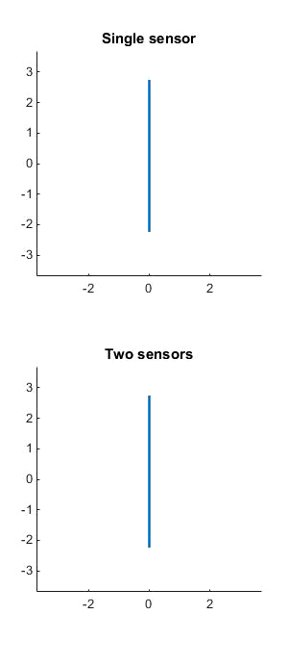
Simulation of C1 and C2 Using model M2
Controller C1
Controller C2

Slide 12
Advantages of C2
Structural stability margin enhancement
Reduction of stiffness / weight possible
Enhancement of range
Vibration reduction
Reduction of noise on seeker sensors

Slide 13
Weight Reduction

Slide 14
Link Lightening – Model M3
Optional centered actuator
Pivot link
Booster
Dart

Slide 15
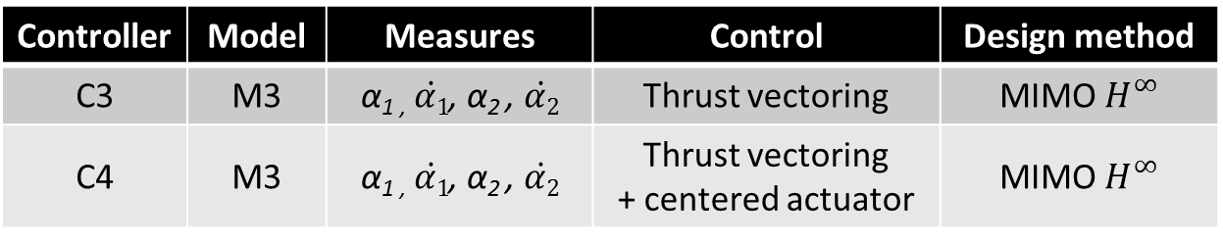
Controller Design
Controller | Model | Measures | Control | Design method
C3 | M3 | α_{1 ,} $\dot{α1}$, α₂ , $\dot{α2}$ | Thrust vectoring | MIMO $H^{∞}$
C4 | M3 | α_{1 ,} $\dot{α1}$, α₂ , $\dot{α2}$ | Thrust vectoring + centered actuator | MIMO $H^{∞}$

Slide 16
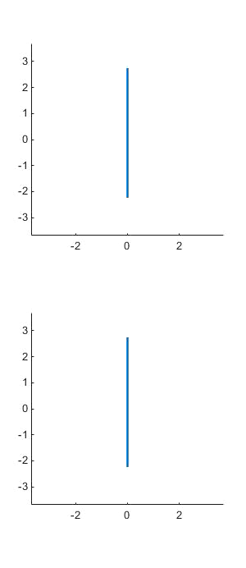
Simulation of C3 & C4 Using model M3
Controller C3
Controller C4

Slide 17
C3 & C4 Advantages
Light link (single bolt)
Reduction of weight
Simplification of pyrotechnics
C3
No need of an extra actuator
Consumes less
C4
Enhanced stability

Slide 18
Conclusion
Multiple sensors / Multiple actuators advantages
Less vibration for sensors / Enhanced tracking
Weight alleviation / Range increase
Pyrotechnics simplification
Further research
Precise structural and aerodynamic model needed
Make controllers implementable
Robustness studies

Slide 19
Thank You
Anatole Verhaegen,
a.verhaegen@cranfield.ac.uk

